Slide 1
Lecture 05
Mathematics in Computer Science

Slide 2
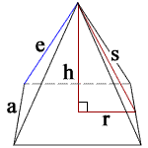
What is mathematics?
Mathematics is defined as the science which deals with logic of shape, quantity and arrangement.
During ancient times in Egypt, the Egyptians used math's and complex mathematic equations like geometry and algebra. That is how they managed to build the pyramids.
Mathematics is basically related to understanding structure. It is used to do logical analysis, make relevant calculations and eventually to deduce conclusions and pattern.

Slide 3
Role of Math in CS
What is the importance of the ground in building?
If you don’t have an understanding of the foundation on which you place a structure, that structure may be fairly wobbly and will fail over time.
Same is the case here with Computer Science

Slide 4
Mathematics is prominent at every layer of Computing:
The lowest layer with ALU performing the Arithmetic and logical operations.
The middle layer with Operating system making use of mathematics and algorithms for process management, memory management, disk management, networking operations and more.
The upper layer with all sort of application and system software using all sort of algorithms to create all sort of magic.
Right now, when you are reading this text, there is mathematics going on behind the scenes to render it on your screen taking into account specific font face/size/color/monitor's resolution/aspect ratio/X,Y coordinates etc. with different algorithms contributing to the final result.

Slide 5
Mathematics applications

Slide 6
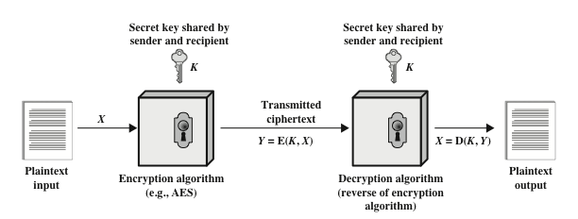
Mathematics in Cryptography
Cryptography is a method of storing and transmitting data in a particular form so that only those for whom it is intended can read and process it.
Plain Text: meet me after the toga party
Cipher: PHHW PH DIWHU WKH WRJD SDUWB
Each element is shifted 3 times to the right

Slide 7
Activity-01
Can you decipher (Decode) the following messages?
1. Zujge oy ixoiqkz sgzin hkzckkt Vgqoyzgt gtj Otjog
(Key is 6: Shifted Rightward)
2. tnemeveihca ot sdael taht htiaf eht si msimitpO

Slide 8
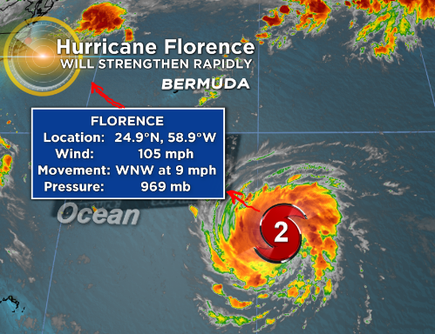
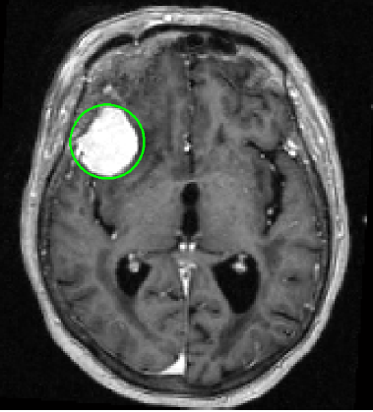
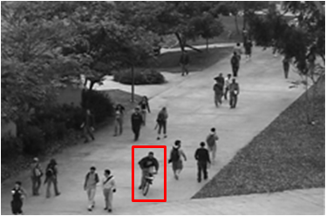
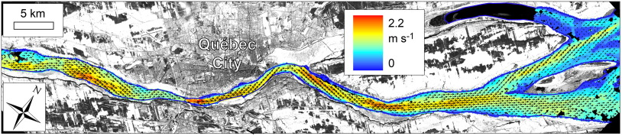
Image Processing & Computer Vision
Detecting/tracking Hurricanes
Cancer/Tumor Detection
Anomaly Detection
Movement detection from satellite images
…and many more
All these applications required heavy mathematical operations

Slide 9
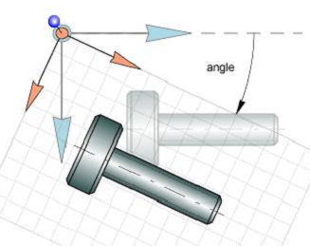
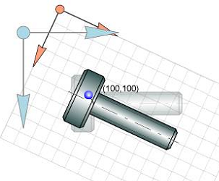
Robotics
In robotics 3D linear and rotational motion are involved
Understanding of different coordinate systems are necessary to describe position
Coordinates to describe position.
rectangular (x,y,z)
cylindrical (r,θ,z)
spherical (r,θ,ϕ)
Similarly pose estimation and object holding
required complex maths
Simple rotation Rotation & translation

Slide 10
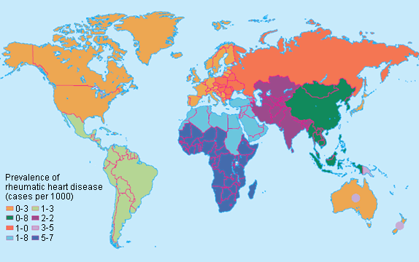

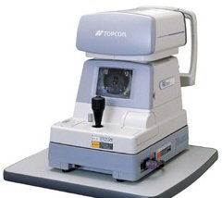
Epidemiology
Epidemiology is the branch of medicine which deals with the incidence, distribution, and possible control of diseases and other factors relating to health.
What is your hearth rate now? How you measure it? 100 beats/min
How smart devices measure blood pressure, heart rate and sugar?
How the computerized eye-sight checking machine (Auto-Refractometer) works?
All these techniques required math at backend.

Slide 11
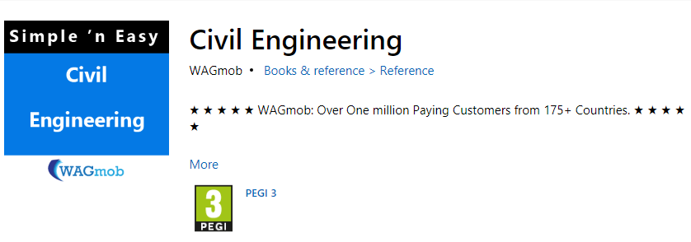
Math in CS Civil Engineering Apps
WAGmob brings you, Simple and Easy, on-the-go learning app for "Civil Engineering". The byte sized app helps you to understand the basics of "Civil Engineering".
How to develop such applications without understanding of mathematics?

Slide 12
Math in CS Mechanical Engineering apps
Some applications for 3D designing in the field of Mechanical Engineering
AUTODESK
INVENTOR
Etc.
All these application needs heavy math at back end.
As in given figure there are Force, Rotation, Momentum and Velocity involved.
By changing one quantity effects other quantities and the changes can be measured/observed through computer

Slide 13

Concept of Optimization
In mathematical terms, an optimization problem is the problem of finding the best solution from among the set of all feasible solutions.
In simple terms optimization is choosing INPUTS that will result in the best possible OUTPUTS

Slide 14
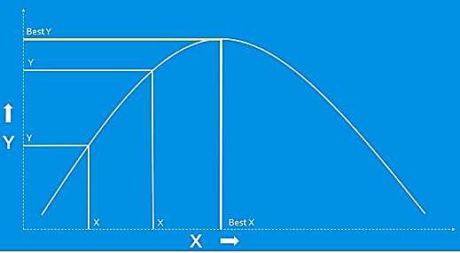
Optimization
Let’s take a look at a very simple example of an optimization problem:
Given a parabola, chose x to get the largest y. We can try different x values to see the resulting y value.
Eventually we can find the maximum y value by choosing Best X.
You may also have solved this type of problem in calculus class by taking the derivative of the parabola and setting it equal to zero.

Slide 15
Where can we use OPTIMIZATION?

Slide 16
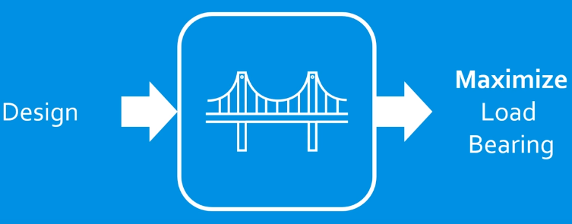
Bridge Construction
Designing a bridge that can carry the maximum load possible for a given cost.
Input is Design and output is to Maximize Load Bearing

Slide 17
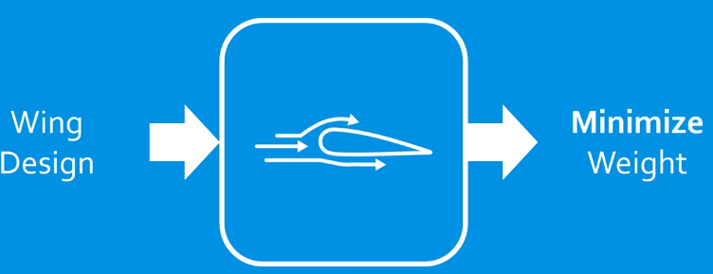
Airplane Wing Design
Design an airplane wing to minimize weight while maintaining strength.
Input is Wing Design and output is to Minimize Weight

Slide 18
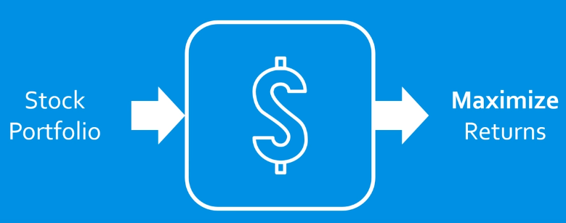
Stock Market
Selecting the best set of stocks to invest in to maximize returns based on predicted performance.
Input is Stock Portfolio and Output is to maximize returns on investment

Slide 19
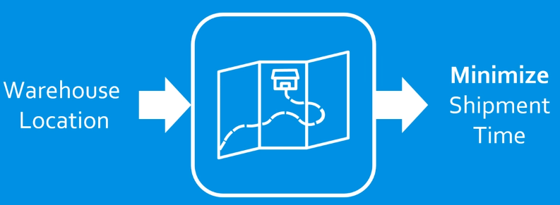
Warehouse placement
Choosing the optimal location for a warehouse to minimize shipment times to potential customers.

Slide 20
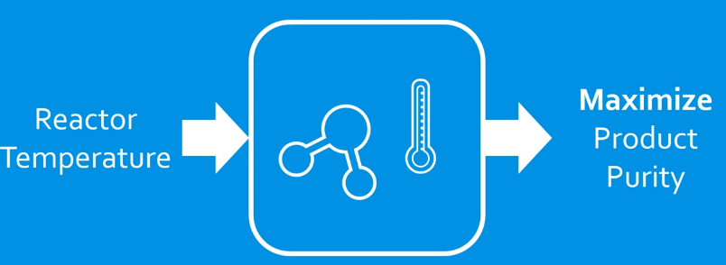
Temperature control of a chemical reaction
Controlling the temperature of a chemical reaction throughout a process to maximize the purity of a desired product.

Slide 21
Space Shuttle / Suborbital Vehicle trajectory optimization
Even optimization is involved in life critical missions
Trajectory of space shuttle is calculated and optimized to its target position by minimizing fuel cost and time.

Slide 22
Optimization Continue…
As you can see, optimization is a powerful tool in many applications.
This is just a small sampling of the many fields that make use of optimization techniques to improve the quality of their solutions.
If something can be modeled mathematically, it can usually be optimized.

Slide 23
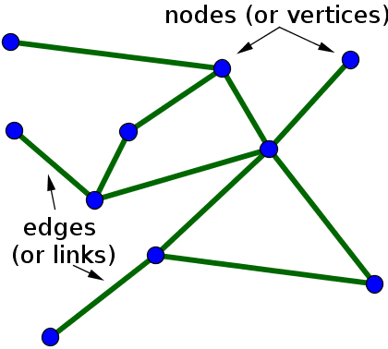
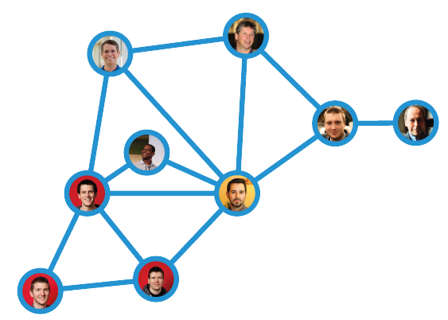
Introduction to Graph
In Computer Science, graph is a collection of connected NODES (vertices) with the help of EDGES (links)
A node is a thing or an entity and we can assign some value to it, so a person, a car and a city are examples of a node.
An edge can be define as a relation of some sort between two or more nodes
A perfect layman's example might be Facebook.
The network of you, your friends, and their friends etc. are collectively referred to as the social graph
Here people are nodes connected through friendship edges

Slide 24
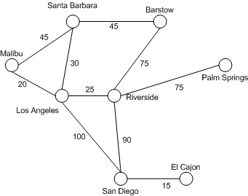
Graph
Similarly we can shows connected cities using graph as in given figure
Cities are represented as nodes (vertices) and the road’s distance is represented on edges.

Slide 25
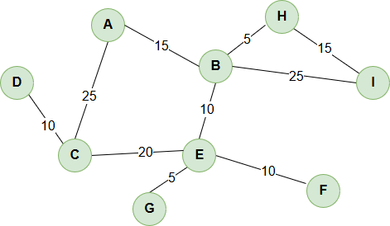
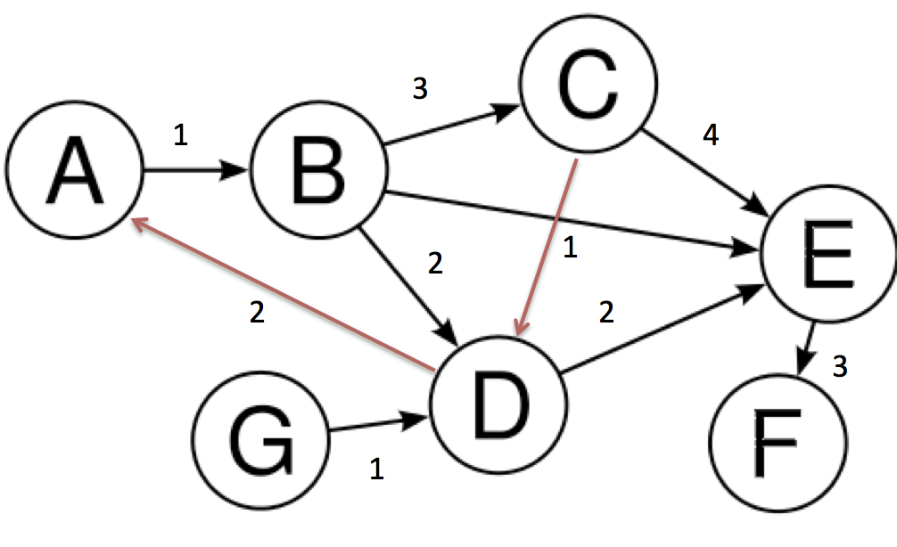
Types of Graphs
There are two types of graphs
Undirected
Directed

Slide 26
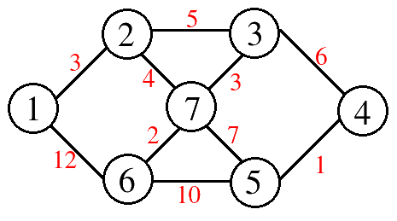
Representation of Graph in Computer
Adjacency Matrix
Vertices | 1 | 2 | 3 | 4 | 5 | 6 | 7
1 | 0 | 3 | 0 | 0 | 0 | 12 | 0
2 | 3 | 0 | 5 | 0 | 0 | 0 | 4
3 | 0 | 5 | 0 | 6 | 0 | 0 | 3
4 | 0 | 0 | 6 | 0 | 1 | 0 | 0
5 | 0 | 0 | 0 | 1 | 0 | 10 | 7
6 | 12 | 0 | 0 | 0 | 10 | 0 | 2
7 | 0 | 4 | 3 | 0 | 7 | 2 | 0

Slide 27
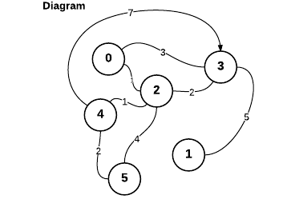
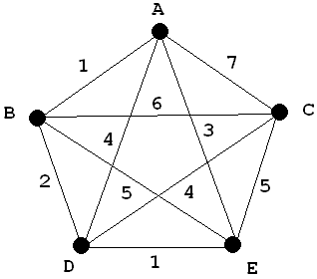
Activity-02 Represent the following graph in form of adjacency matrix

Slide 28
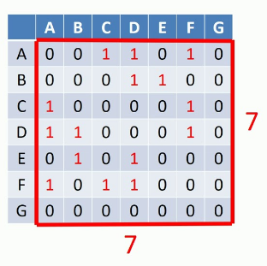
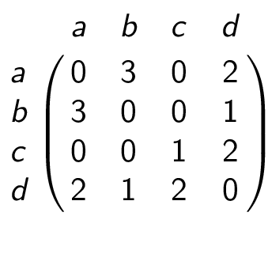
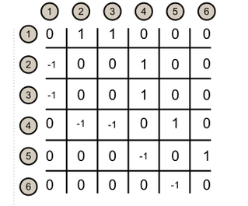
Activity-03 Draw a graph from each of the following adjacency matrices

Slide 29
Working with Graphs

Slide 30
Point to Ponder
Do you know:
How does facebook suggest friends?

Slide 31
Finding shortest path between two nodes
Finding shortest path
Can you find the shortest path between node 1 and 5 in given graph?

Slide 32
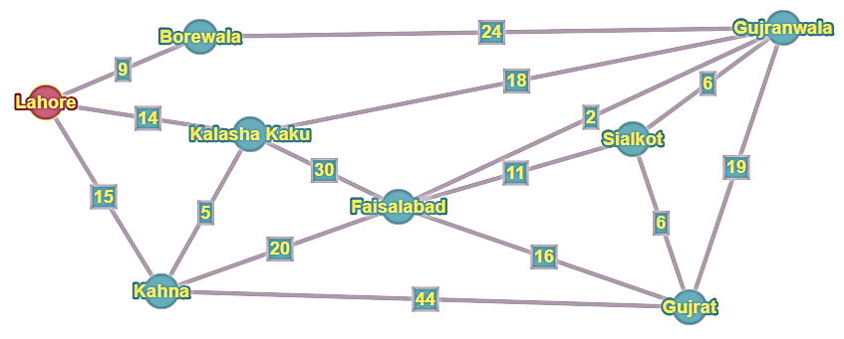
Activity-04
Can you find the shortest path from Lahore to Gujrat?

Slide 33
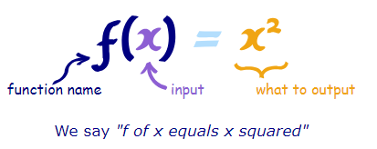
Functions
A function relates an input to an output.
It is like a machine that has an input and an output. And the output is related somehow to the input
Representation of a function
https://www.mathsisfun.com/sets/function.html

Slide 34
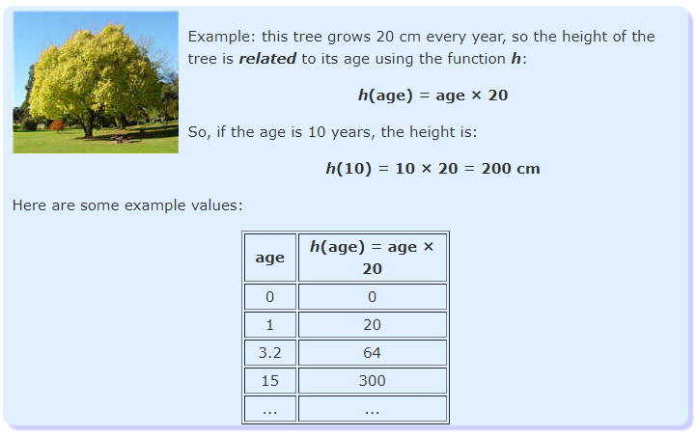
A function relates an input to an output. How?

Slide 35
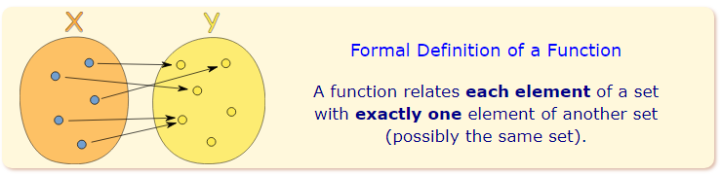
A function has a special rule
It must work for every possible input value
And it has only one relationship for each input value

Slide 36
End of Lecture 04

